Slide 1
PROBLEMS
TO COMMON
GITHUB IS A
SOLUTION
WHAT IS
WHAT COULD BE

Slide 2
THE PROBLEMS
WHAT IS

Slide 3
FRAGMENTATION
GIT
SVN
OTHER
NOTHING
GITHUB
BITBUCKET
GITLAB
OTHER
- problem

Slide 4
BARRIERS
ES
IFAS
WCB
- problem

Slide 5
COLLABORATION
Collaboration is hard to find!
- problem

Slide 6
REINVENTING THE WHEEL
- problem

Slide 7
RISK
WORLD
UF
LEGEND
SERVERS
CODE
PASSWORDS
- problem

Slide 8
THE SOLUTION
WHAT COULD BE

Slide 9
FRAGMENTATION
GIT
GITHUB
- solution

Slide 10
BARRIERS
IFAS
ES
WCB
- solution

Slide 11
COLLABORATION
SHARE / REUSE
CONTRIBUTE
HELP
GET HELP
- solution

Slide 12
REINVENTING THE WHEEL
Solve a problem. Share it.
- solution

Slide 13
RISK
WORLD
UF
LEGEND
SERVERS
CODE
- solution

Slide 14
IN REVIEW
FRAGMENTATION
BARRIERS
REINVENTING THE WHEEL
COLLABORATION
RISK

Slide 15
TAKE HOME
What could be outshines what is!

Slide 16
NOW LET’S GO ON A JOURNEY

Slide 17
TO LEARN ALL ABOUT GIT AND GITHUB

Slide 18
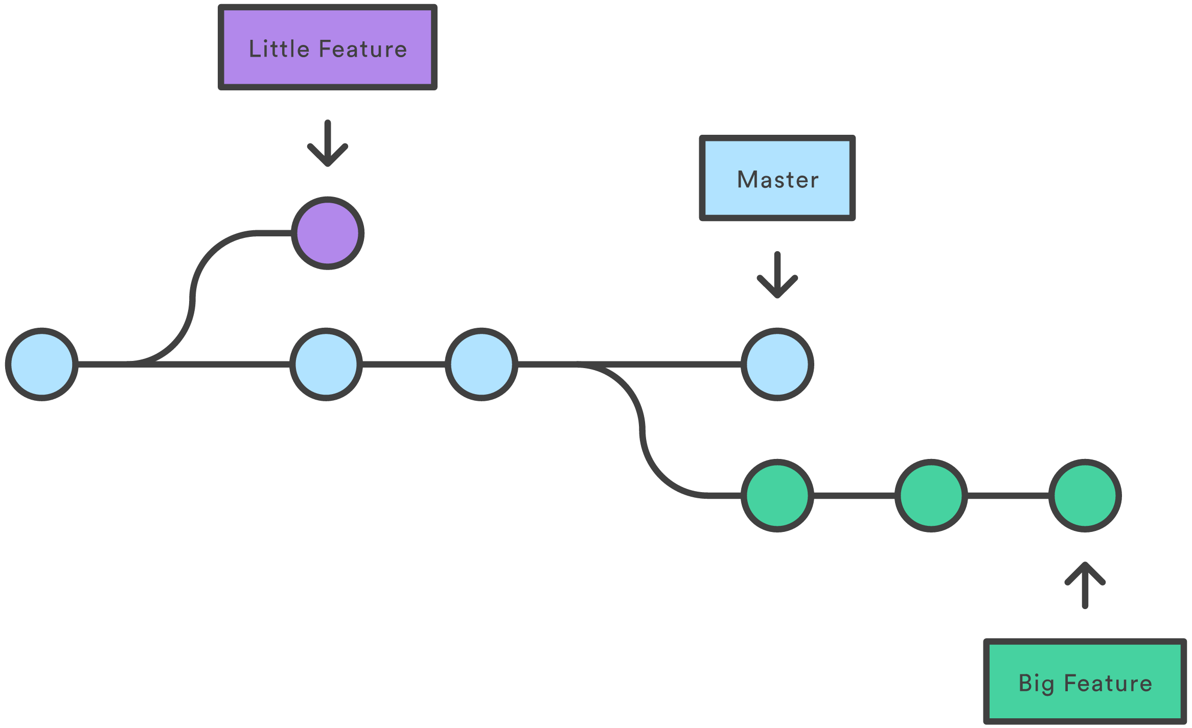
WHAT IS GIT?
Snapshots of code changes over time that can be undone or revisited

Slide 19
A SMART CHOICE

Slide 20
4 REASONS FOR GIT
01
Multiple people
03
Time travel
02
Modularity
04
Work offline

Slide 21
MULTIPLE PEOPLE

Slide 22
MULTIPLE PEOPLE
Multiple people can work on the same file at the same time without destroying each others work
Leads to greater productivity (more people), and quality (more eyes)

Slide 23
MODULARITY/BRANCHES
Feature
Bug
Master is always deployable…

Slide 24
MODULARITY/BRANCHES
Makes it less likely unfinished work will accidentally mix-in with production code
Prevents us from having things like index1.html, index2.html, index3.html, etc.
Leads to greater productivity and quality

Slide 25
MODULARITY/BRANCHES
FEATURES
EXPERIMENTS
BUGS

Slide 26
FEATURES MODULARITY
Feature A
Feature B
Master is always deployable…

Slide 27
FEATURES MODULARITY
Break problems into manageable features
Easily switch between features
Feature A is no longer desired; Delete it
Feature B is impossible or a disaster; Delete it

Slide 28
EXPERIMENTS MODULARITY
Experiment 1
Experiment 2
Master is always deployable…

Slide 29
EXPERIMENTS MODULARITY
Test any idea without fear of compromising your project
Try multiple approaches to the same problem and keep the best

Slide 30
BUGS MODULARITY
Bug to squash
Big Feature
Master is always deployable…

Slide 31
BUGS MODULARITY
You can squash a bug with multiple features or experiments in development

Slide 32
TIME TRAVEL

Slide 33
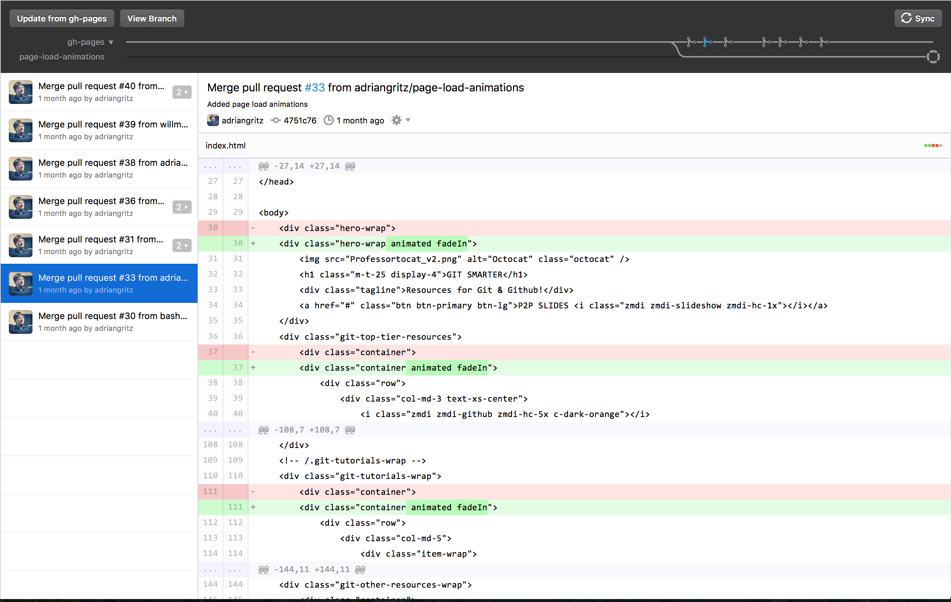
TIME TRAVEL

Slide 34
TIME TRAVEL
Go back to any point in the history of development and review or restore code
Remember what and why you did something in the past or in the present

Slide 35
WORK OFFLINE

Slide 36
WORK OFFLINE
On a plane, train, or automobile
Anywhere you can take a computer
Since Git is distributed you always have a backup of the entire history of your project

Slide 37
GIT IN REVIEW
1
2
3
4
5
Multiple People
Modularity/
Branches
Time Travel
Work Offline
Productivity
& Quality

Slide 38
PRODUCTIVITY
TAKE HOME
QUALITY

Slide 39
WHAT IS GITHUB?
HOSTING (GIT SERVER)
COMMUNICATION (WEB INTERFACE)
ACCESS (READ, WRITE, ADMIN)
COLLABORATION (SHARE, REUSE)

Slide 40
A SMART CHOICE

Slide 41
USED BY
GOOGLE
OPEN SOURCE
MICROSOFT
US GOV
APPLE

Slide 42
ALSO USED BY
MIT
PRINCETON
UNIVERSITY OF MINNESOTA
NCSU
YALE

Slide 43
GITHUB
WORLD
UF
- in the cloud

Slide 44
GITHUB
WORLD
UF
- on premise

Slide 45
PUBLIC / PRIVATE ACCESS
WORLD
UF
TEAM
APP
READ, WRITE, ADMIN

Slide 46
10 REASONS FOR GITHUB
01
Fragmentation
06
Productivity
02
Git hosting
07
Quality
03
Access
08
Security
04
Web interface
09
Communication
05
Adoption
10
Collaboration

Slide 47
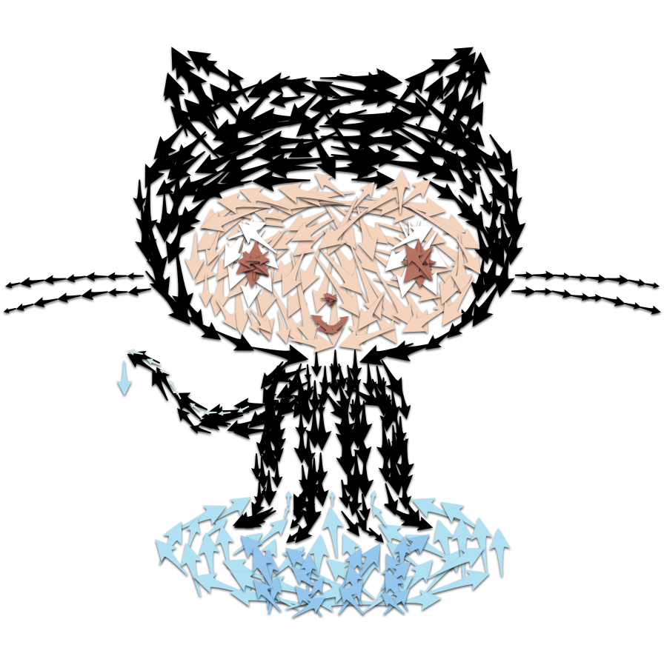
FRAGMENTATION
Decreases
Notes:
Github hosting lowers barriers to entry skill wise. We know that adoption has huge benefits on productivity & quality

Slide 48
FRAGMENTATION
BARRIERS
REINVENTING THE WHEEL
COLLABORATION
RISK

Slide 49
GIT HOSTING
Lowers barrier to adopting version control skill wise

Slide 50
ACCESS
Lowers barrier to collaboration
read, write, admin, url

Slide 51
WEB INTERFACE

Slide 52
WEB INTERFACE
View your code from any device/location
Every line is a reference for a future need
Total transparency
See the history of everything
Diffs in the browser
Collaboration tools
Communication tools

Slide 53
PRODUCTIVITY
Increases

Slide 54
PRODUCTIVITY
GIT
Multiple people (more hands on deck)
Modularity
Time travel
Work offline
WEB INTERFACE
View code from any device/location
Every line is a reference for a future need
Collaboration tools
Communication tools

Slide 55
QUALITY
Increases

Slide 56
QUALITY
GIT
Multiple people (more eyes)
Modularity
Time travel
WEB INTERFACE
Code reviews can catch mistakes

Slide 57
ADOPTION OF VERSION CONTROL
Increases

Slide 58
ADOPTION OF VERSION CONTROL
Hosting made easy
Productivity and quality gains
Web interface
Access control made easy
Support from UFIT
A great opportunity since a lot of people are still not using version control
Smart phone analogy

Slide 59
SECURITY
Increases

Slide 60
RISK SECURITY
WORLD
UF
LEGEND
SERVERS
CODE
PASSWORDS
- problem

Slide 61
RISK SECURITY
WORLD
UF
LEGEND
SERVERS
CODE
- solution

Slide 62
UF SERVERS SECURITY
Private IP’s and other security magic

Slide 63
AUDITABLE SECURITY
File permissions, passwords, known vulnerabilities

Slide 64
SHIB, AD, 2FA SECURITY

Slide 65
FEAR OF CLOUD HOSTING SECURITY
Kills collaboration opportunities

Slide 66
NON SYS ADMINS SECURITY
Frontend awesome!
Backend noob!
Installing, updating, and patching LAMP and Windows servers for Git & SVN hosting

Slide 67
COMMUNICATION
Increases

Slide 68
COMMUNICATION
ISSUES & LABELS
CODE REVIEW
MILESTONES
COMMENT & DISCUSS
MARKDOWN
WIKI
All project communication in one place

Slide 69
COMMUNICATION
EIS HOSTING DOCUMENTATION
SHIBBOLETH DOCUMENTATION
FAQ’s
Can be crowd sourced

Slide 70
COLLABORATION
Increases

Slide 71
BARRIERS
IFAS
ES
WCB
- solution

Slide 72
COLLABORATION
SHARE / REUSE
CONTRIBUTE
HELP
GET HELP

Slide 73
COLLABORATION EXAMPLE

Slide 74
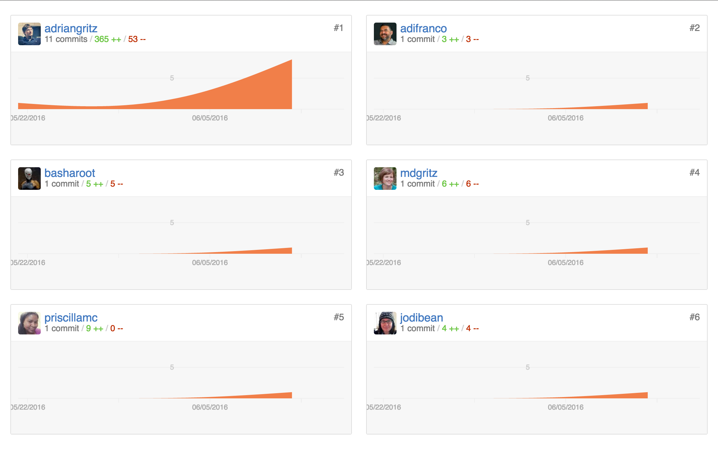
CONTRIBUTORS

Slide 75
COLLABORATION
FORK
COMMITS
CODE REVIEW
BRANCH
PULL REQUEST
MERGE
GitHub Flow / Feature Branch Workflow

Slide 76
FORK GITHUB FEATURE
Contribute
Feature
Bug
Head start
Copy a project you don’t have access to
into your account

Slide 77
BRANCH GIT FEATURE
A parallel copy of project within your own account to work on a feature, bug, etc.

Slide 78
COMMIT GIT FEATURE
A batch of code changes with a message

Slide 79
PULL REQUEST GITHUB FEATURE
A notification to original owner that you completed a feature or fixed a bug

Slide 80
CODE REVIEW GITHUB FEATURE
Original owner reviews feature or bug fix

Slide 81
MERGE GIT FEATURE
Original owner merges feature or bug fix into original project

Slide 82
COLLABORATION
FORK
COMMITS
CODE REVIEW
BRANCH
PULL REQUEST
MERGE
GitHub Flow / Feature Branch Workflow

Slide 83
THE VALUE IN REVIEW
Access
Hosting
Fragmentation
Web Interface
Productivity

Slide 84
THE VALUE IN REVIEW
Adoption
Communication
Quality
Security
Collaboration

Slide 85
TAKE HOME
Github provides a lot of value!

Slide 86
PEOPLE CARE
This is important to many people!

Slide 87
GITHUB YES PLEASE
WCM survey had 94 replies
Peer to peer had 10

Slide 88
OPINIONS FROM PEOPLE WHO CARE
01
I like this.
04
This topic is the first useful thing I have seen on yammer.
02
Love the potential networking and sharing of creativity.
05
This would be a welcome resource for code-sharing in and among UF projects.
03
This would greatly benefit all of UFIT and would be worth any expense.
06
I think it is short sighted for UFIT to not try to centralize and protect the code that is being written to conduct official UF business.

Slide 89
A LOT OF THANKS

Slide 90
A LOT OF THANKS
Thanks for taking this initiative. I support this effort.
I really want the push for Github for the Enterprise to be successful.
Thank you again for taking the time and effort to make this process more visible.
Thank you!
Great job you have my appreciation!
Thanks for putting this together!
Notes:
These people did not have to take the time out of their busy schedules to thank me.

Slide 91
PEERS AROUND CAMPUS
I hope it gets funded! It would be awesome! Thank you!

Slide 92
IF THEY WERE HERE
They might say pretty please with a
cherry on top!

Slide 93
TAKE HOME
People care!

Slide 94
LETS IMAGINE A FUTURE
Where we put it all together!
- put your imagination glasses on

Slide 95
GITHUB IS APPROVED

Slide 96
A SYMBOL FOR COLLABORATION

Slide 97
EVERYONE CELEBRATES

Slide 98
1 ODD SIDE EFFECT
What could it be?

Slide 99
DEVELOPER HAPPINESS
Increases
Notes:
Github hosting lowers barriers to entry skill wise. We know that adoption has huge benefits on productivity & quality

Slide 100
DEVELOPER HAPPINESS
31% MORE PRODUCTIVE
3x MORE CREATIVE
- Harvard Business Review

Slide 101
GOODBYE FRAGMENTATION
GIT
SVN
OTHER
NOTHING
GITHUB
BITBUCKET
GITLAB
OTHER

Slide 102
GOODBYE REINVENTING THE WHEEL

Slide 103
WE GET A LOT OF VALUE
Access
Hosting
Fragmentation
Web Interface
Productivity

Slide 104
A LOT OF VALUE
Adoption
Communication
Quality
Security
Collaboration

Slide 105
A LOT OF OPPORTUNITY
IFAS
ES
WCB

Slide 106
TO SOLVE PROBLEMS AND SHARE SOLUTIONS
So others don’t have to reinvent the wheel

Slide 107
USING A COMMON LANGUAGE/TOOL
GIT
GITHUB

Slide 108
IN A SECURE ENVIRONMENT
WORLD
UF
LEGEND
SERVERS
CODE
- risk

Slide 109
FOR EMPOWERED DEVELOPERS

Slide 110
To build some extraordinary things!!!

Slide 111
TOGETHER

Slide 112
CALL TO ACTION

Slide 113
THE FUTURE
The future is not a place we go!

Slide 114
THE FUTURE
The future is a place we make!

Slide 115
IT’S YOUR TIME

Slide 116
TO SHINE

Slide 117
FOR APPROXIMATELY THE COST OF 1FTE

Slide 118
YOU HAVE THE POWER

Slide 119
TO PROMOTE A CULTURE

Slide 120
THAT BRINGS PEOPLE TOGETHER

Slide 121
ENCOURAGES COLLABORATION
SHARE / REUSE
CONTRIBUTE
HELP
GET HELP

Slide 122
AND THAT IS A CULTURE I WANT TO BE A PART OF

Slide 123
QUESTIONS?
Collaboration
Productivity
Quality
Web Interface
Communication
Adoption
Security
Fragmentation
Access
Hosting

